Slide 1
BAXTER COUNTY
ARKANSAS

Slide 2
PLAY ALL DAY, THEN GO HOME TO YOUR PLACE!
Less than 15 minutes from Tracy Ferry Marina
45 minutes to Bull Shoal Caverns
Great dining options in your sister city, Mountain Home
Wonderful Fishing
ALL the boating fun!

Slide 3
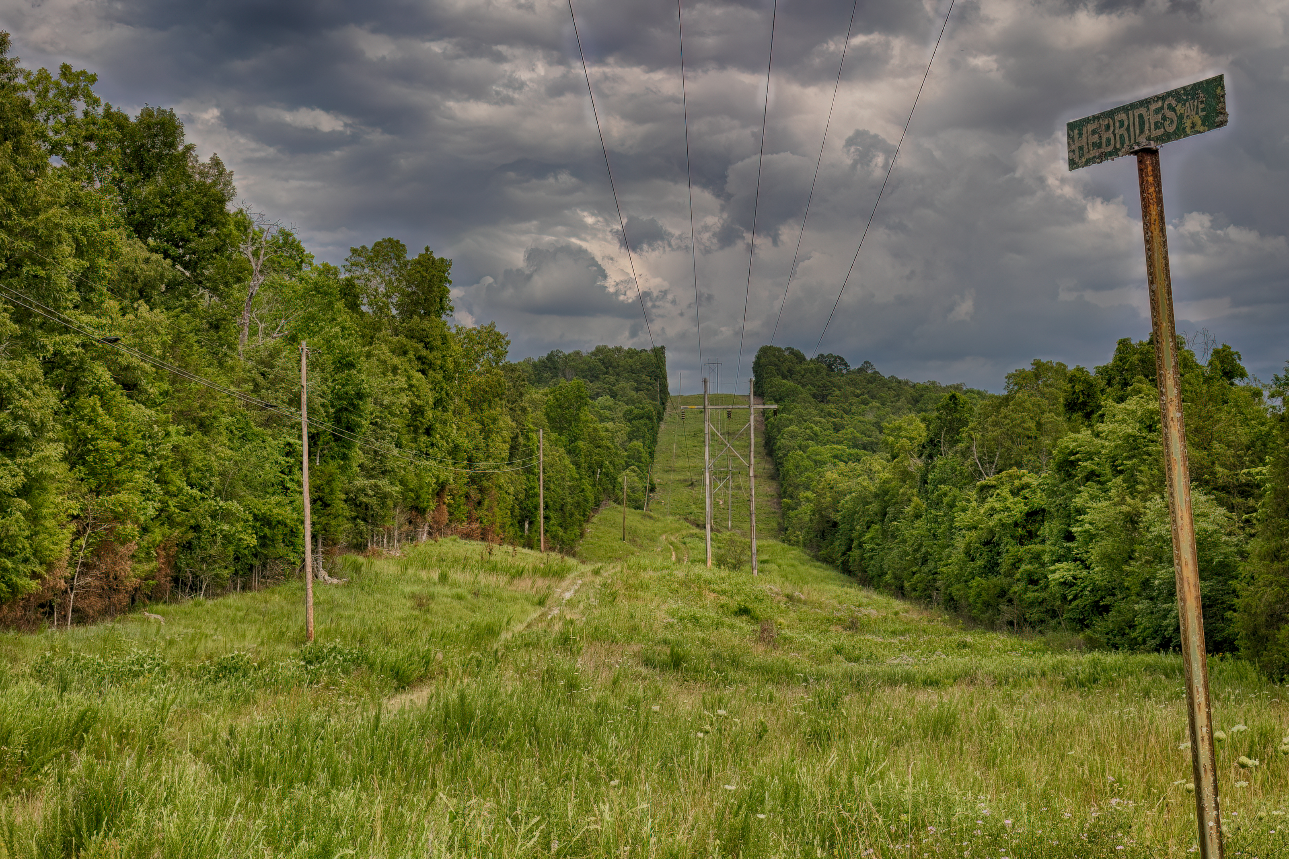
FEATURES | DESCRIPTION
County, State | Baxter, AR
Size | 0.26 Acre
APN | 010-02238-000
Terrain | Gently Sloped
Zoning | Residential
Taxes | $90.11
HOA | No

Slide 4
GOOGLE EARTH IMAGE
Closest Highway – Hwy 177 S, Salesville (4 miles, 8 minutes)
Home, Barn, Mobile Homes, etc. can be built on this property
No HOA

Slide 5
PRICED TO SELL!
OWNER FINANCING | 48 MONTHS
Down Payment | $195.00
Document Fee | $100.00
Financed Portion | $4,800.00
Monthly Payment | $100.00
Monthly Prorated Taxes | $5.00
Monthly Note Fee | $5.00

Slide 6
NOW WHAT? LET US DO THE WORK?
Relax while we do the work! We will record the deed with the county. We ask all the questions about zoning. We provide owner financing. It really is THAT EASY. (OR, ask us about our discounted cash pricing!)

